Slide 1
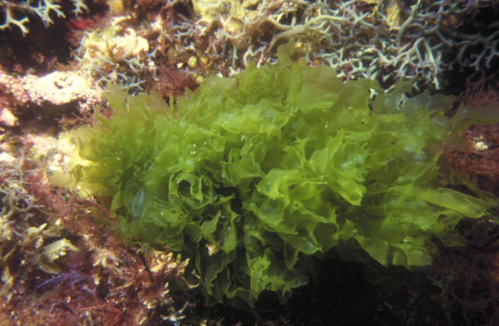
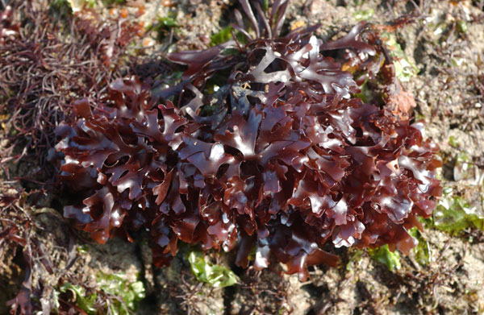
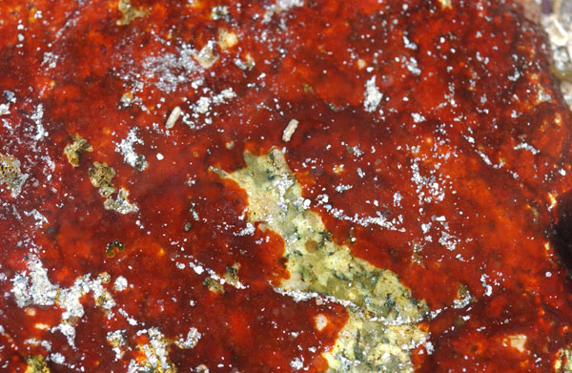
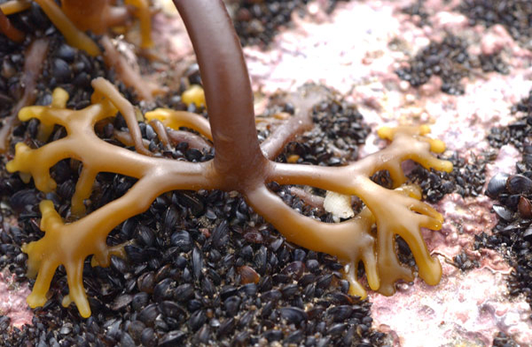
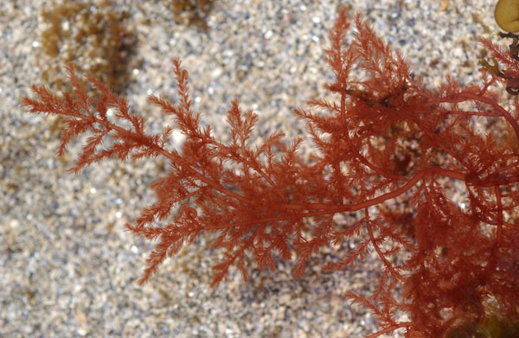
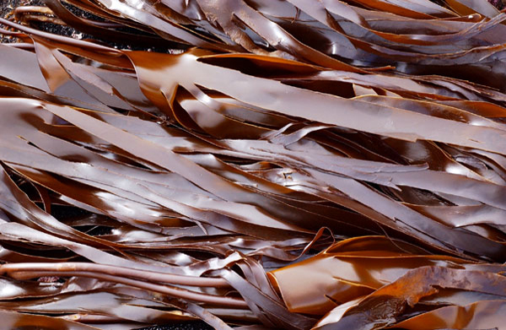
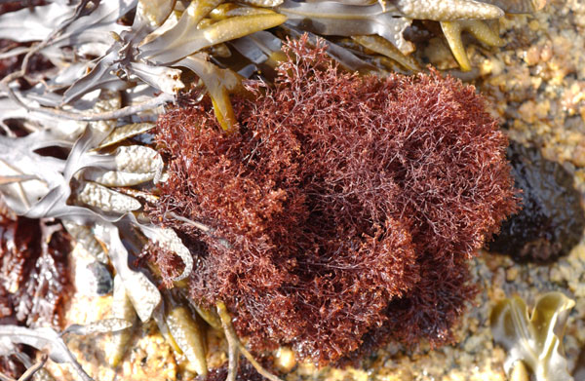
The Macroalgal Herbarium Consortium
Accessing 150 Years of Specimen Data to Understand Changes in the Marine/Aquatic Environment

Slide 2
What are Macroalgae?
Eukaryota Tree of Life (Bauldauf 2003)

Slide 3
What are Macroalgae?
Rhodophyta (Red Algae) - 6,300 species in 10 orders
Chlorophyta (Green Algae) - 4,300 species in 15 orders
Charophyta - 3,500 species in 8 orders
Phaeophyta (Brown Algae) - 2,000 species in 18 orders

Slide 4
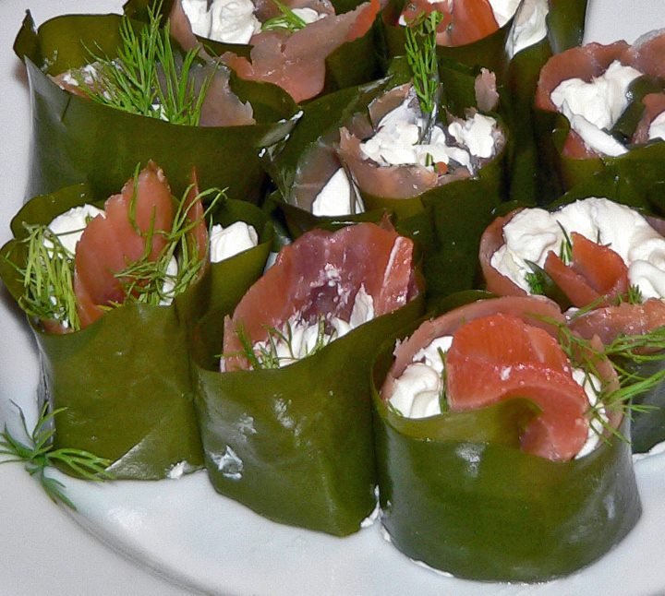
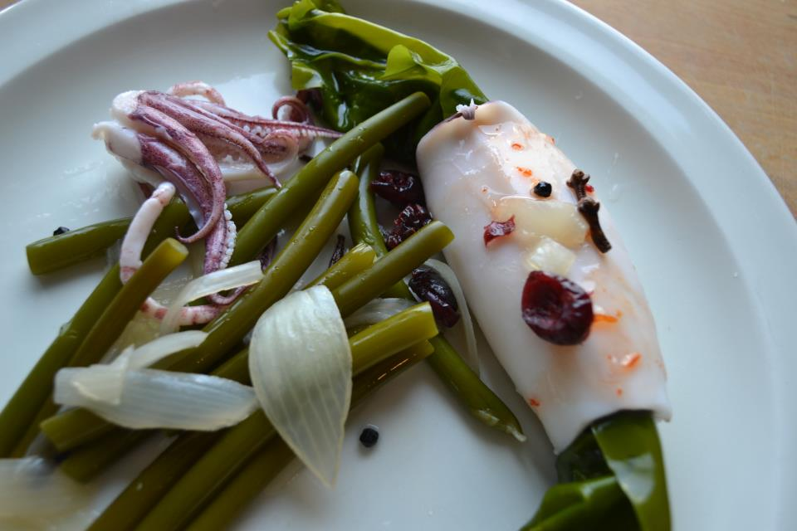
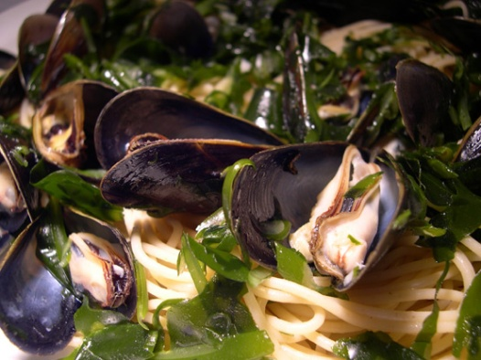
Why Are They Important?
Foundation of aquatic ecosystems – provide food, shelter and substrate for other organisms
Maintain nutrient balance in aquatic ecosystem and produce oxygen
$7.4 billion industry as human food, phycocolloids, pharmaceuticals
Sensitive indicator of environmental changes in aquatic ecosystems

Slide 5
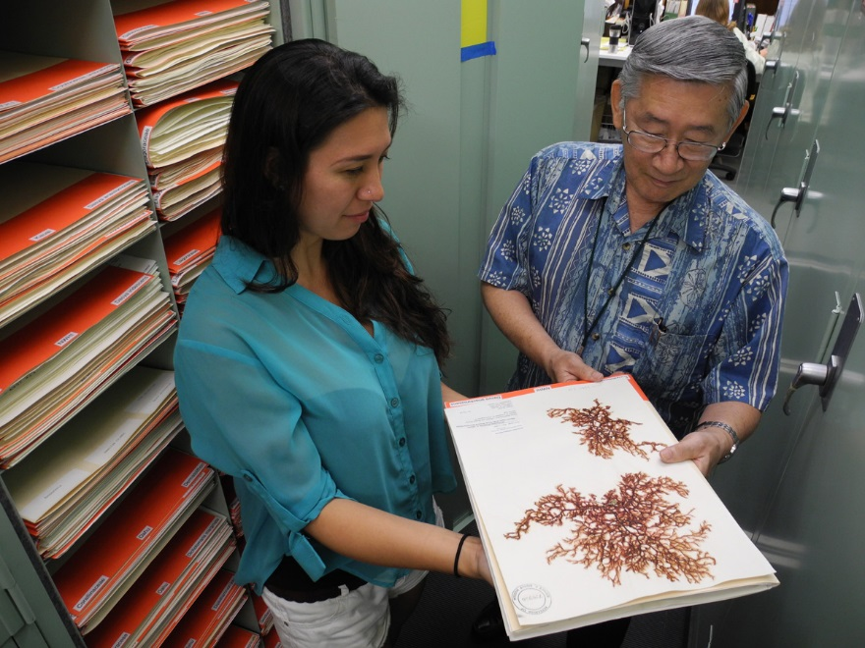
How Many Specimens Are There in US Herbaria?
1.2 Million in collections ranging from 100 specimens to 200,000.
Project goal is to digitize (image, database, georeference) all of them.

Slide 6
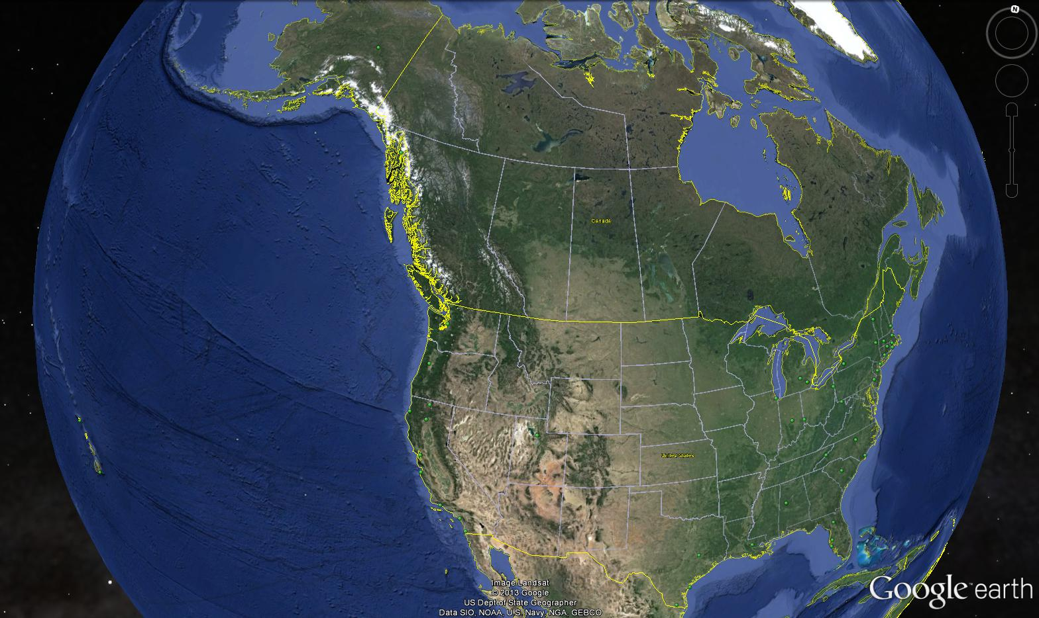
Where Are The Specimens?
Macroalgal Herbarium Consortium

Slide 7
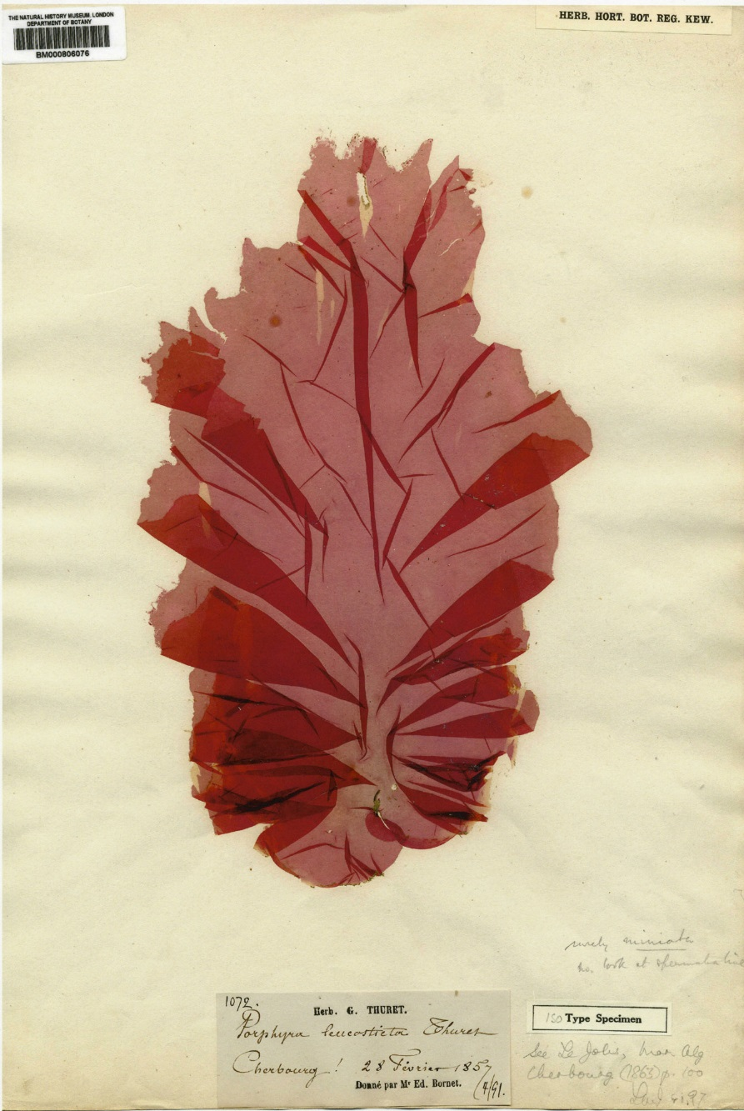
What Information Do They Contain?
Label Information
Taxonomic determinations and annotations, collector(s), collection date, locality, habitat, depth, associated species, etc.
Specimen
Gross, morphological characteristics, reproductive status, general condition.
DNA
Cellular characterisics

Slide 8
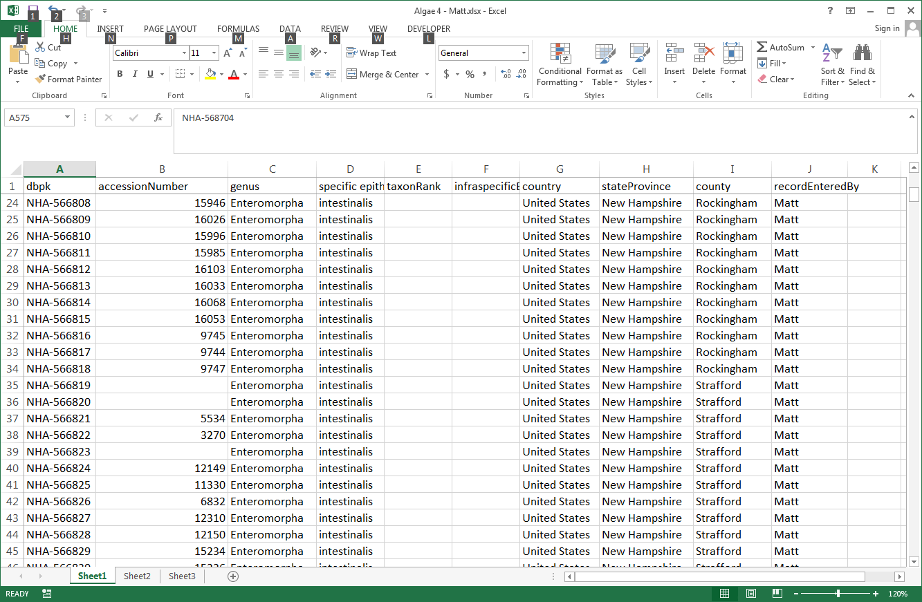
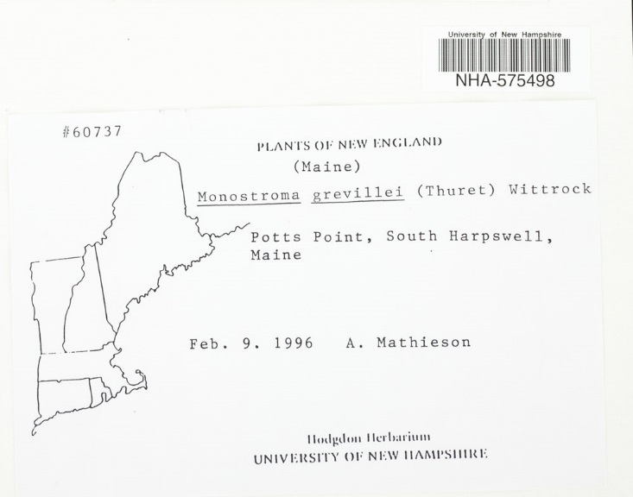
How Are They Being Digitized?
Barcoding and Skeletal Record Creation
Manual/semi-automated entry
Barcode,
filed-as name,
country, state, county)

Slide 9
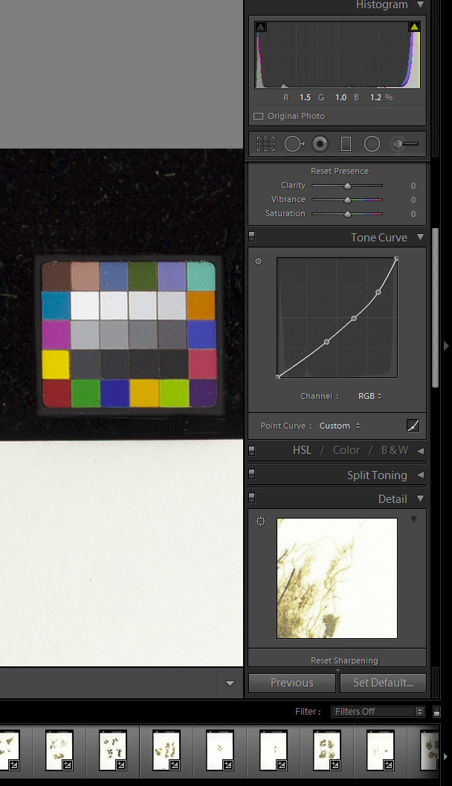
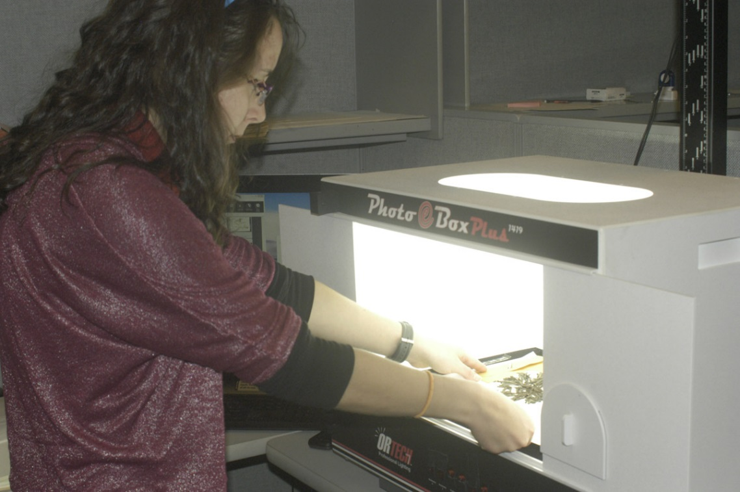
How Are They Being Digitized?
Imaging
Lightbox/copystand
21 to 36 megapixel camera
Camera Control Software
Adobe Lightroom (white balance, tone curve adjustment, jpg & dng export)

Slide 10
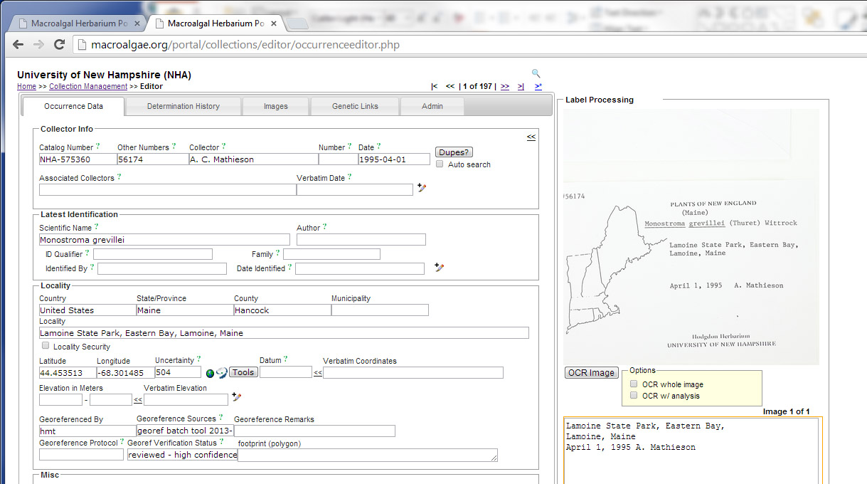
How Are They Being Digitized?
Label Transcription
Voice recognition (collector(s), collection date, accession number,
Optical character recognition (locality)
Web service from AlgaeBase via WoRMS(currently recognized name, taxonomic authorities)
Crowdsourcing
Habitat, annotation notes and other details

Slide 11
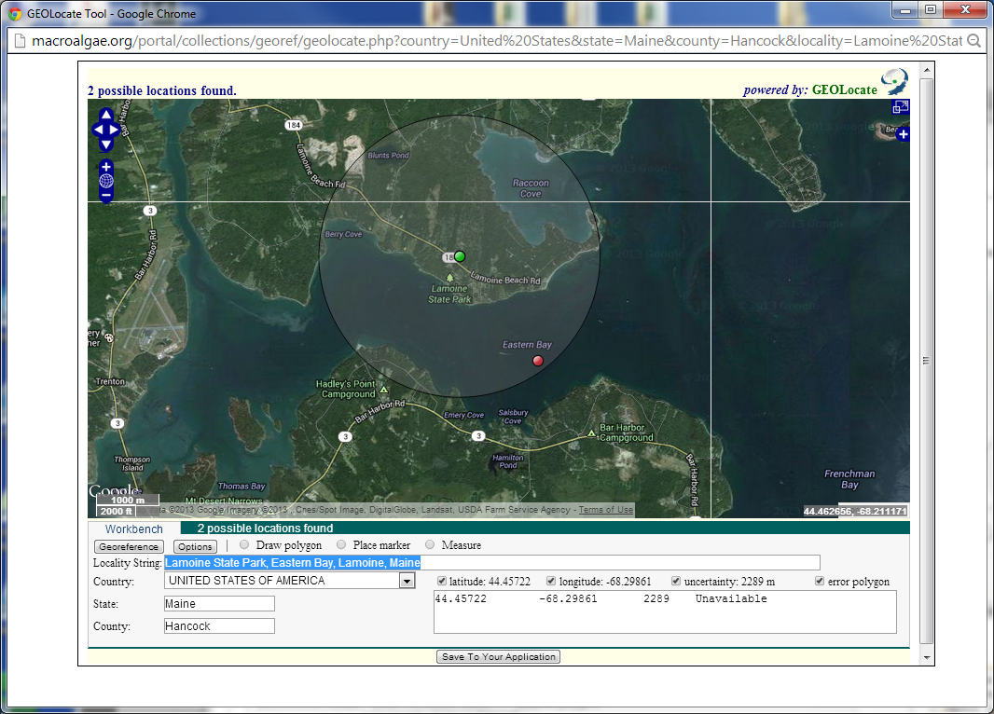
How Are They Being Digitized?
Georeferencing
GEOlocate (from Symbiota portal)
Locality Information from Label
Field Notebooks

Slide 12
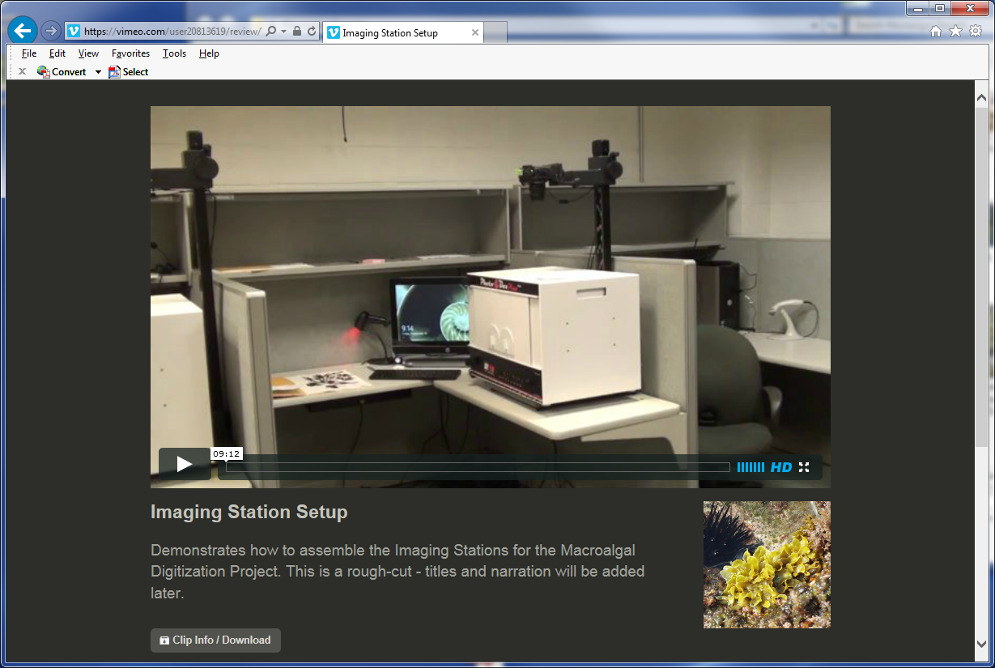
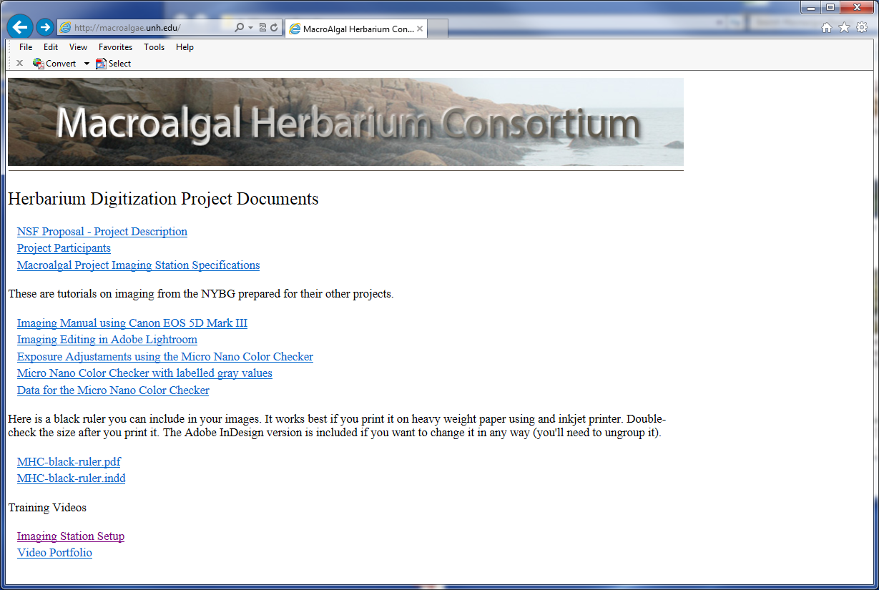
How are digitizers being trained?
Tutorials and Videos
Macroalgae.unh.edu
Vimeo
Virtual Meetings and Workshops
Adobe Connect
On-site training

Slide 13
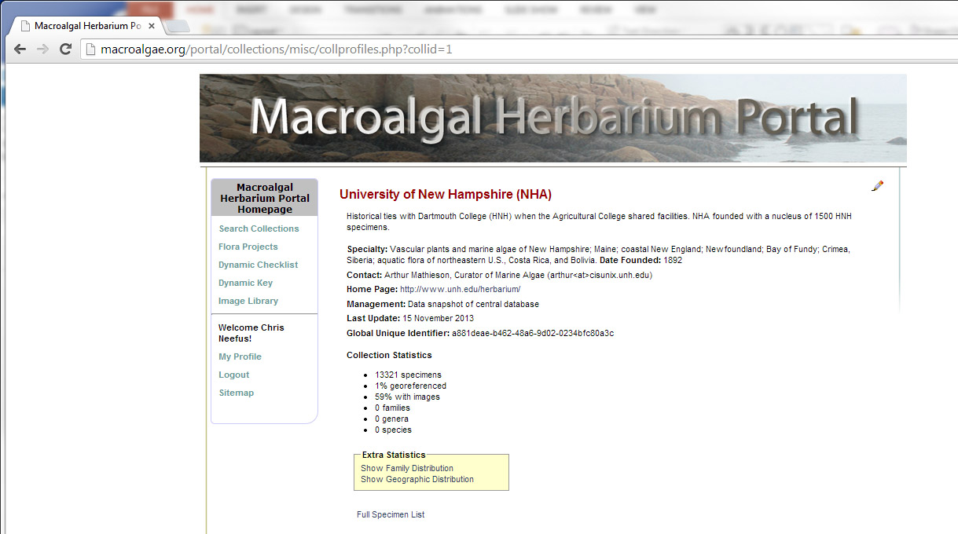
How Is The Data Being Disseminated?
Macroalgae.org specimen data portal (Symbiota)

Slide 14
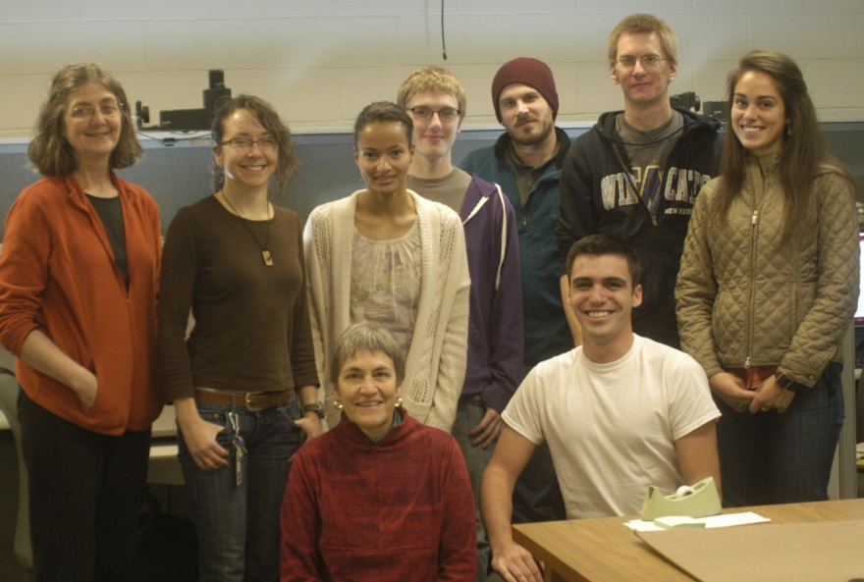
What Are The Broader Impacts of the Project?
Undergraduate and Graduate Student Participation
Digitization: Imaging, Transcription, Georeferencing
Research Opportunities
Internships at NY Botanical Garden and Field Museum
Under-represented groups in STEM
Exhibits and Programs
Field Museum (650,000 visitors)
Bishop Museum (450,000 visitors)

Slide 15
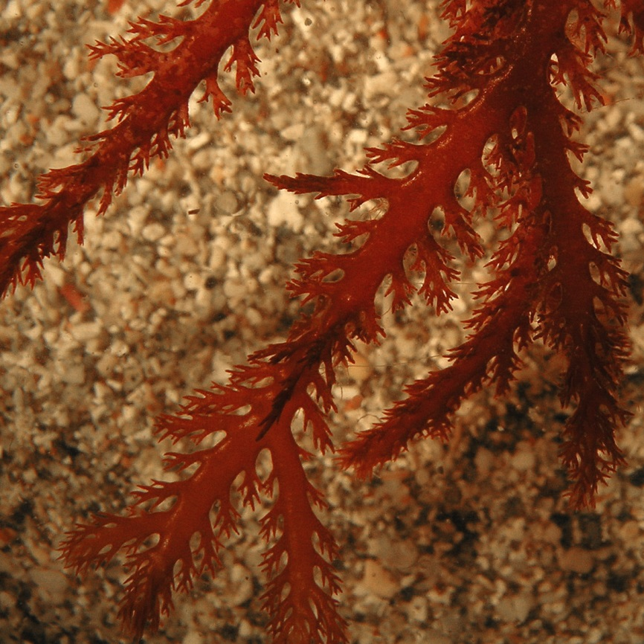
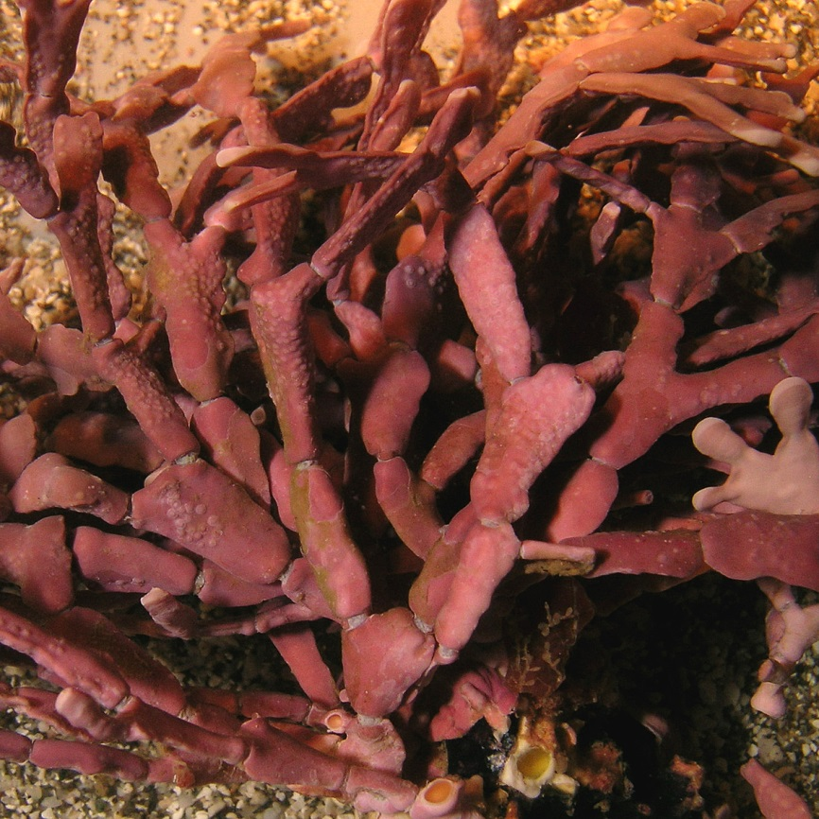
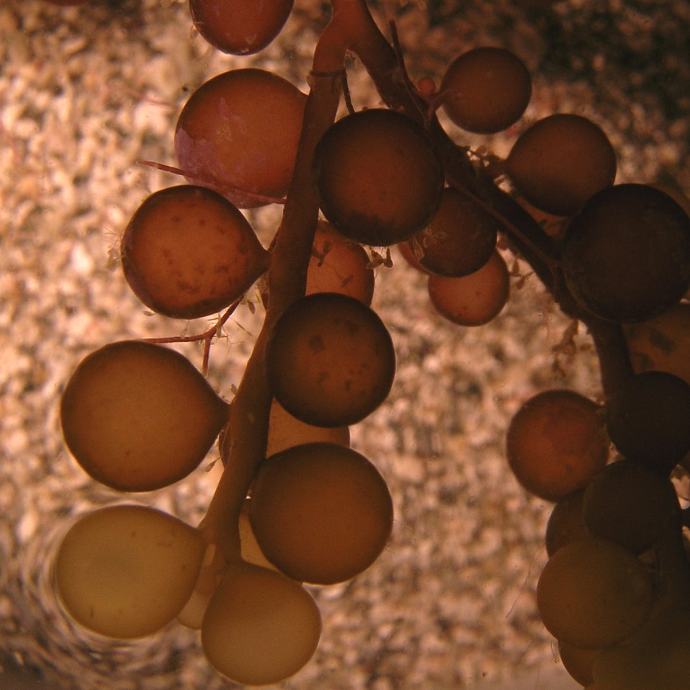
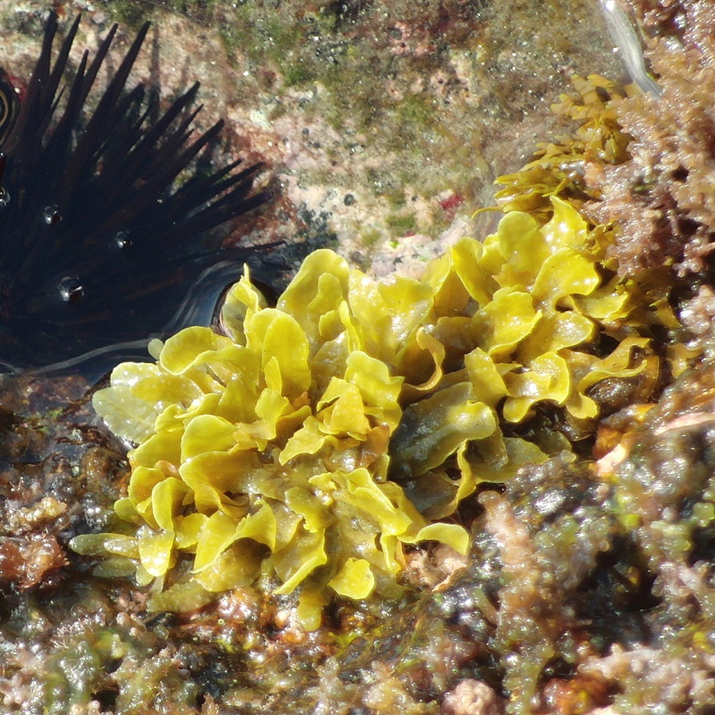
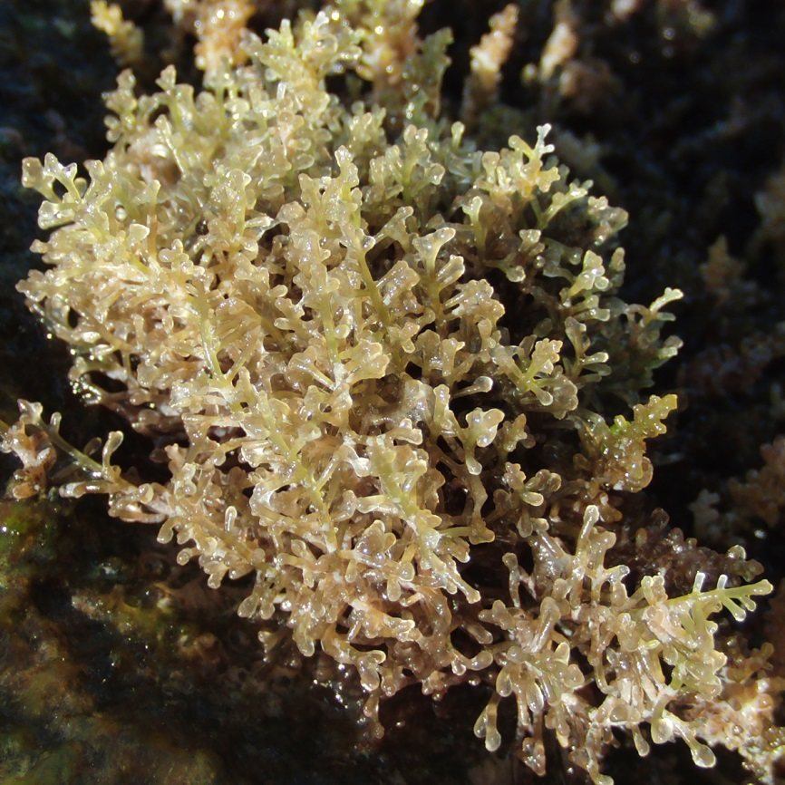
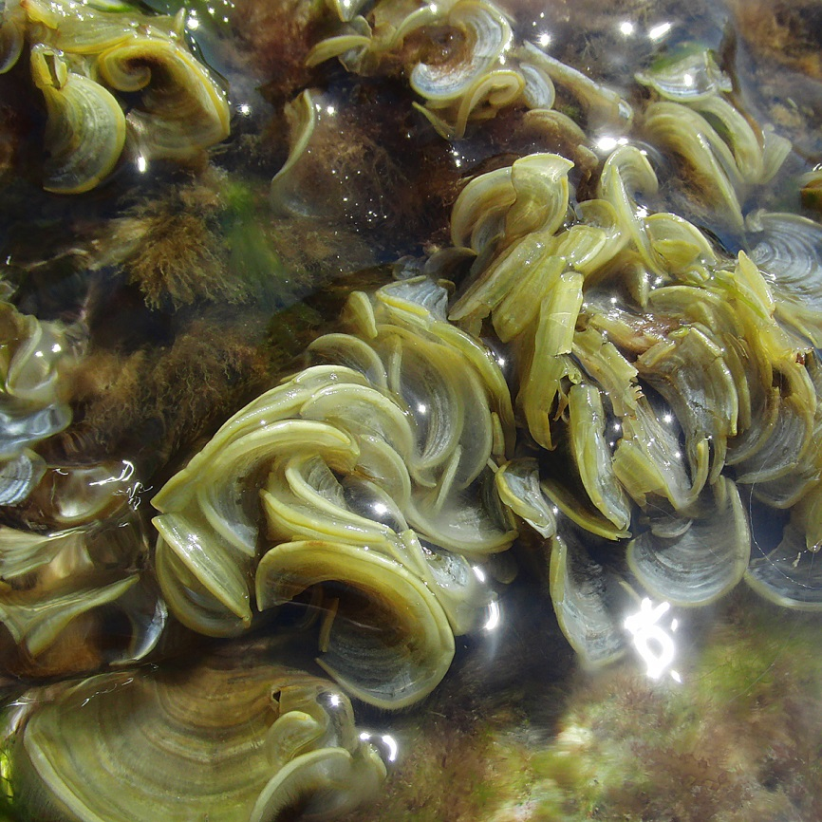
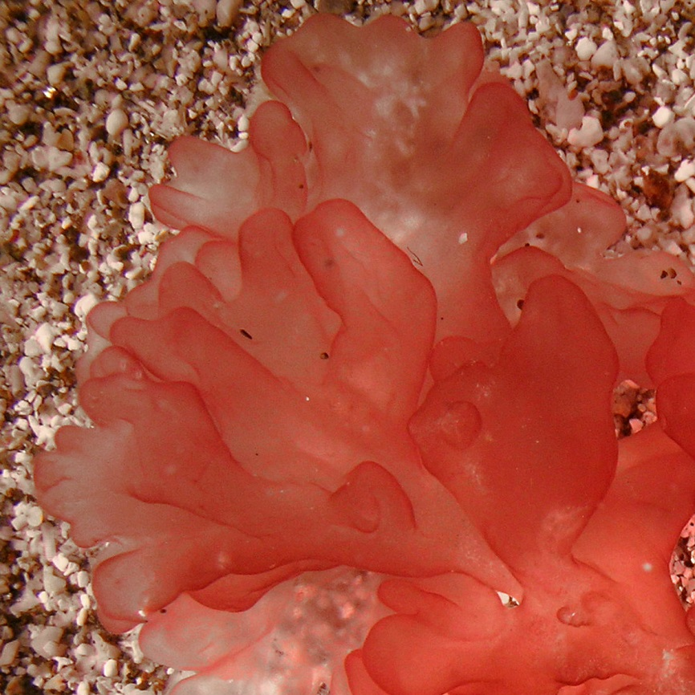
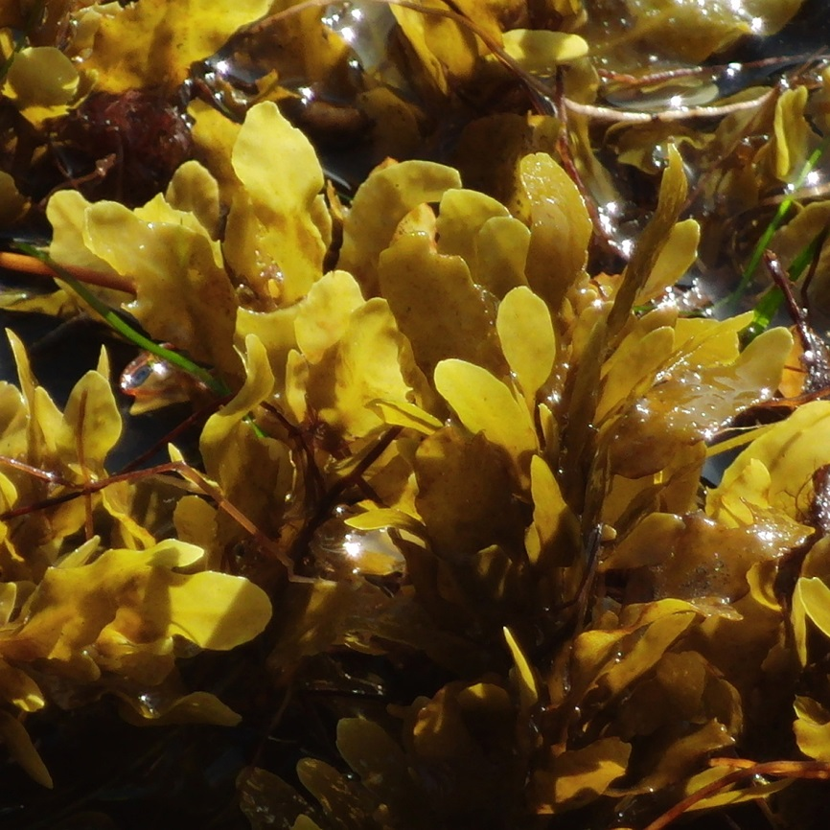
Photographs by Robert Lücking

